Slide 1
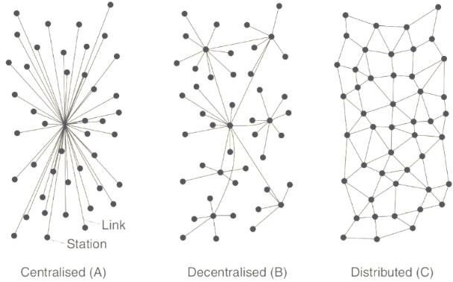
Transaction Distribution

Slide 2
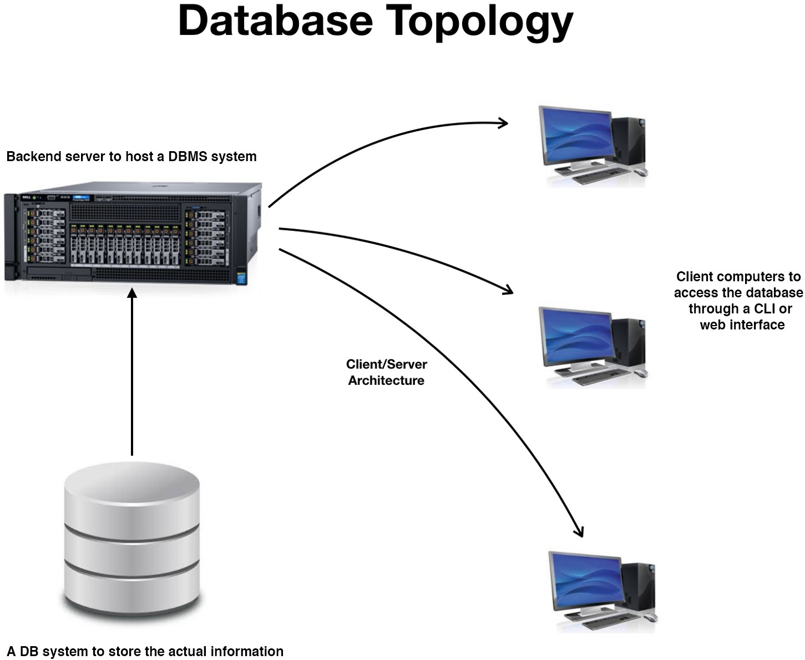
Database Topology

Slide 3
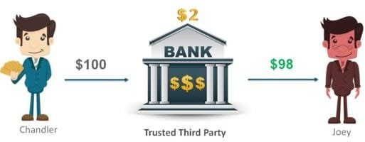
Current Banking System

Slide 4
Problems with current system
Account Hacking
Internet Frauds
High Transaction Costs
High Transaction Time due to intermediaries
Dependency on Banks

Slide 5
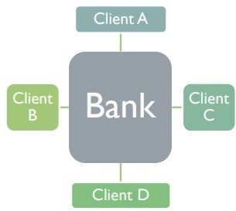
Typical Database Architecture

Slide 6
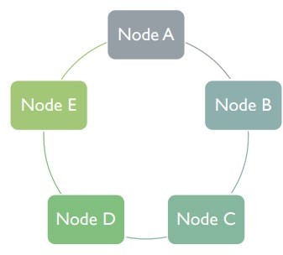
Typical Blockchain Architecture

Slide 7
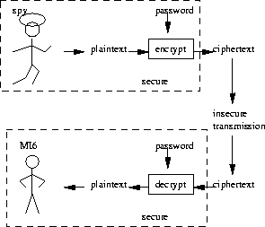
Introduction to Cryptography
Cryptography is an important aspect when we deal with network security. ‘Crypto’ means secret or hidden.
Source: Stanford

Slide 8
Types of Cryptography
Symmetric aka Private Key Cryptography
Asymmetric aka Public Key Cryptography

Slide 9
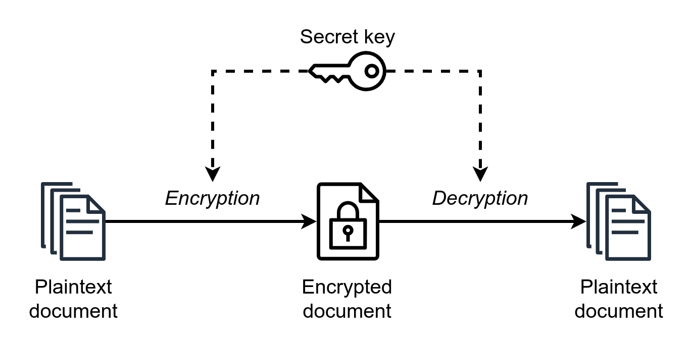
Symmetric Cryptography

Slide 10
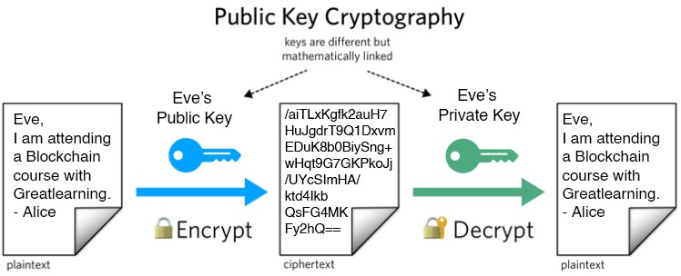
Asymmetric Cryptography

Slide 11
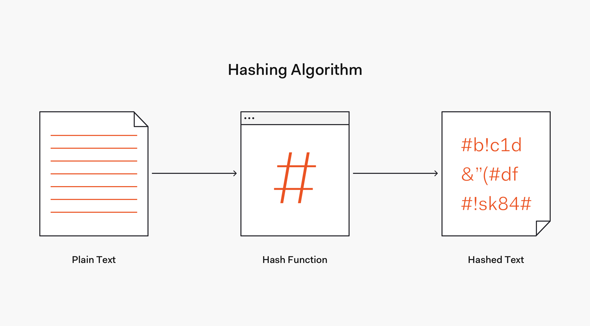
Hashing

Slide 12
What exactly is Blockchain?
The blockchain is general terms is defined in following manner:
A technology that permits transactions to be recorded permanently.
A technology that cryptographically secure the system and chains data in chronological order.
A technology that remove intermediaries and create trust through the algorithm.
Blockchain was first introduced in the white paper for Bitcoin in 2009 by unknown person named as Satoshi Nakamoto. Currently, blockchain is used my multiple organizations to tackle their problems and provide a better solution.

Slide 13
How Blockchain solves the current problem?
Security through Cryptography
Availability through multiple machines
Low transaction costs
Remove of central parties and intermediaries.

Slide 14
Blocks
A Block is a container data structure which contains a set of confirmed transactions.
A block could contain different information, and a chain of these blocks evolves into a blockchain as long as it links one and the other.
The blocks are stored on the hard drives of many miners spread across the globe on a peer to peer network.
In the Bitcoin algorithm, a block is created every 10 minutes. All the transactions happening over the network within 10 minutes interval are crunched into that block and added to the chain.

Slide 15
Structure of Blocks
All blocks in the Blockchain are composed of a header, identifiers and a long list of transactions. The structure of a block is as follows:
Block Header
Block identifiers
Merkle Trees

Slide 16
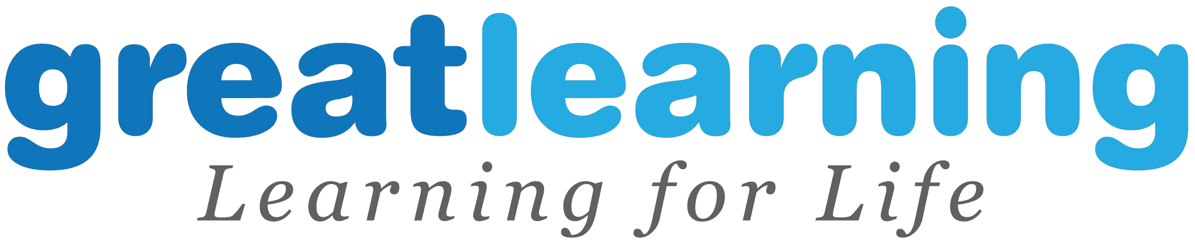
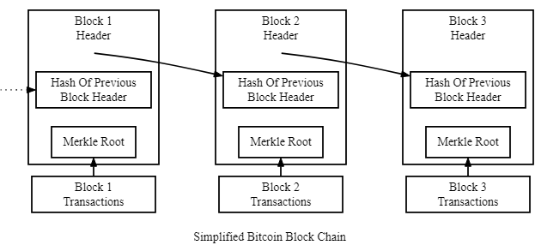
Blocks

Slide 17
Example of Bitcoin Block
Field | Description | Size
Magic No | value always 0xD9B4BEF9 | 4 bytes
Blocksize | number of bytes following up to end of block | 4 bytes
Blockheader | consists of 6 items | 80 bytes
Transaction Counter | positive integer VI = VarInt | 1 - 9 bytes
Transactions | The (non empty) list of transactions | Transaction counter-many transactions

Slide 18
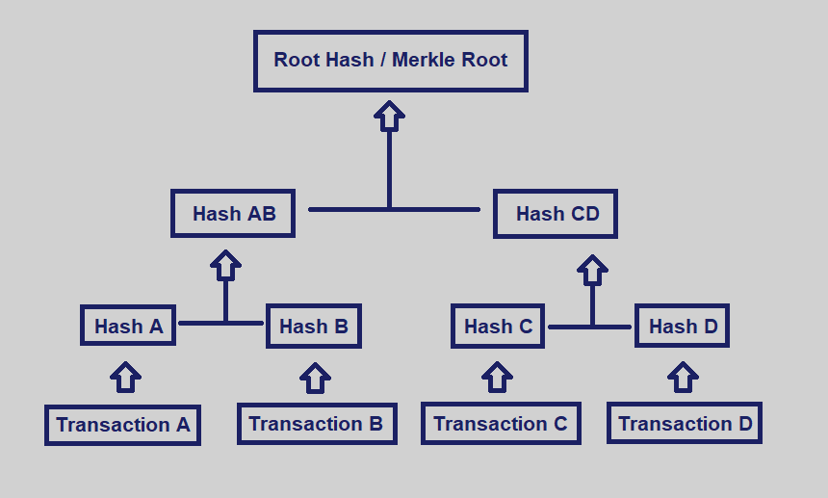
Merkle Tree

Slide 19
Consensus Mechanism

Slide 20
What is Consensus?
Blockchains are decentralized systems which consist of different participants who act depending on incentives they receive and the information that is available to them.
When a new transaction gets broadcasted on the network, nodes connected to the network have the option to either include that transaction to their copy of ledger or to ignore it. When the majority of the nodes which comprise the network decide on a single state, the consensus is achieved.
Let’s dive into 2 Generals Problem and understand the consensus better.

Slide 21
Proof of Work
Proof of Work is the consensus algorithm where miners compete to solve a difficult mathematical problem based on a cryptographic hash algorithm.
Some of the problems included with Proof of Work are:
Hash function - how to find the input knowing the output.
Integer factorization - how to present a number as a multiplication of two other numbers.
Guided tour puzzle protocol - If the server suspects a DoS attack, it requires a calculation of hash functions, for some nodes in a defined order. In this case, it’s a ‘how to find a chain of hash function values’ problem.
Miners receive a reward when they solve the complex mathematical problem.
For example in Bitcoin miners receive 12.5 bitcoins for solving the puzzle.
Miners can also receive transaction fees in addition to rewards.

Slide 22
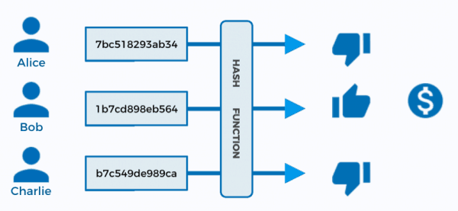
Proof of Work

Slide 23
Proof of Stake
Proof-of-Work algorithm rewards miners who solve complex mathematical problems with the end goal of validating transactions and creating new blocks. On the other hand, in the Proof-of-Stake algorithm, the creator of a new block is chosen in a deterministic way, depending on its wealth/stake in the blockchain.
No block reward
All the digital currencies are created at the start of the chain, and their number never changes. Miners only take the transaction fees.

Slide 24
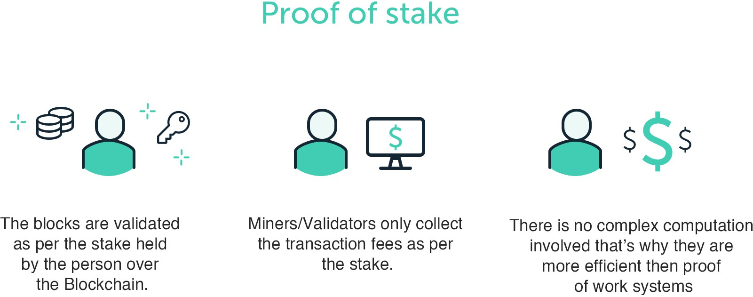
Proof of Stake

Slide 25
Mechanism of Blockchain Transaction

Slide 26
How a Blockchain Transaction Works?
Step 1: A user creates a transaction from their wallet,, attempting to send currency or data to someone else.
Step 2: The transaction is put across a ‘pool of unconfirmed transactions’. This pool is a collection of unconfirmed transactions that are waiting to be processed by the miners.
Step 3: Miners on the blockchain select transactions from these pools and form them into a ‘block’. A block is basically a collection of transactions with some extra metadata. Every miner creates their own block. Multiple miners can put in the same transactions in their block.

Slide 27
How a Blockchain Transaction Works?
Step 4: Once the block is created, miners generates a block signature. This signature is created by solving a complex mathematical problem. Each block has a different mathematical problem as per the transactions.
Step 5: The miner that finds a target signature for its block first, broadcasts this block and the signature to all the other miners.
Step 6: Other miners verify the signature If it is valid, the other miners will confirm its validity and agree that the block can be added to the blockchain. This process is also termed as consensus.

Slide 28
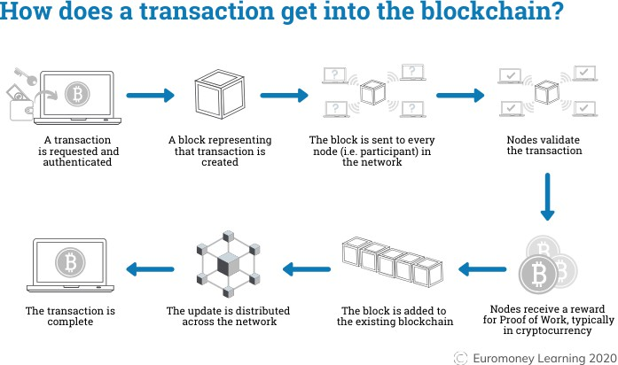
Source: https://www.euromoney.com/learning/blockchain-explained/how-transactions-get-
into-the-blockchain

Slide 29
Blockchain Ecosystem

Slide 30
Blockchain Projects
The Blockchain ecosystem is currently running with some major projects and more are under pipeline. Some of the major projects on Blockchain are:
Bitcoin - This project introduced the world to Blockchain.
Ethereum - This project came with concept of Smart Contracts where two parties adhere to certain rules and create a trust. This opens the world for more decentralized applications.
Neo - This project positioned itself as the “Chinese Ethereum” but it bought the Python as the main language for the creation of Applications.
Hyperledger Fabric - This is an enterprise graded project which can be easily programmed as per the enterprise needs. This is a modular project which supports multiple consensus algorithms.

Slide 31
Blockchain Users
Blockchain users are normal people like you and me, who make use of the blockchain or cryptocurrency to achieve some results. They can also be investors who buy cryptocurrencies to sell at a later date.
For creating a Blockchain user base the technology or cryptocurrency should have some utility related to the problem being tackled.
For Example:
Bitcoin serves the major utility of payment for goods and services. Currently there are over 50,000 merchants registered with Bitcoin including - Microsoft, PayPal and Subway.
Bitcoin was the first mover in Blockchain and it’s high utility as payment system made sure that a large part of its ecosystem is based upon users.

Slide 32
Blockchain Exchanges
Every Blockchain project has a robust ecosystem working under it, and it always include a decentralized exchange. These are developed by the Blockchain team or the community of other developers.
A typical exchange is designed to find the cheapest rates of exchange between any two cryptocurrencies, making it more affordable to trade tokens/cryptocurrencies.
Exchanges used for trading also might integrate with hardware wallets, or users can create their own wallet on the exchange website.

Slide 33
Blockchain Verfiers/Miners
To function a blockchain and maintain its integrity, it needs a large network of independent nodes around the world to maintain it continuously. In private blockchains, a central organisation has the authority over every node on the network. In the case of public blockchains, on the other hand, anyone can set up their computer to act as a node. The owners of these computers are called miners.
Since the integrity of the blockchain is directly related to the number of independent nodes on the network, there also needs to be some incentive to mining. Different blockchains utilize different mining systems however most of them contain some form of:
An incentive system
A consensus algorithm

Slide 34
Blockchain Developers
Blockchain technology is built by the potential of developers working behind it. A strong team of developers can lead to a successful Blockchain project. Currently there are two types of developers in the blockchain ecosystem:
Blockchain developers
dApp developers
Blockchain developers build new blockchains with different levels of functionalities and Consensus Algorithms.
dApp developers work with decentralized applications that can run on blockchains thus providing a similar functionality like Google Play Store over the Blockchain Technology.
The development of Smart Contracts over the Blockchain has open possibility for the developers to create extensive applications and use cases for the industries.

Slide 35
Blockchain Applications
Apart from exchanges, platforms and users, another important aspect of the Blockchain ecosystem is the applications that industries, developers and communities build to serve a specific purpose.
There are various examples of Applications being build upon Blockchain, some of the major working applications are:
CryptPad - A decentralized document creation application.
Humaniq - A fintech startup which connects unbanked people with global economy.
Augur - A peer to peer oracle and prediction market place.
Filament - Building the IoT applications over the Blockchain.

Slide 36
Industry Challenges for Blockchain Adoption

Slide 37
Energy Consumption
Some major public Blockchains use Proof-of-Work algorithms.
PoW involves the use of the computational power of a machine to solve a complex mathematical puzzle to verify a transaction and add it to a block.
Current Bitcoin energy consumption is almost equal to the consumption by Ireland.
By 2020 it’s estimated that Bitcoin will utilize more energy consumption than the entire world currently uses.
A probable solution for this has emerged in the form of different consensus mechanisms like Proof-of-Stake, Delegated-Proof-of-Stake, etc.

Slide 38
Scalability
Scalability has appeared as a significant issue for the Blockchain networks like Bitcoin and Ethereum.
Blockchains are having trouble effectively supporting a large number of users on the network.
Moreover, the size of public blockchains keeps on increasing. Currently, Bitcoin ledger size is above 100 GB.
One possible solution which has emerged is storing a hash of data over the network.

Slide 39
Public Perception
Presently, blockchain technology is almost synonymous with Bitcoin.
The majority of the public is still oblivious to the existence and potential uses of Blockchain technology.
As Bitcoin is anonymous and is used for shadowy dealings of money laundering, black market trade, and other illegal activities. The blockchain is also getting a bad reputation due to the same.
Mainstream adoption is needed to remove the sometimes-negative undertones of Bitcoin.

Slide 40
Standards and Regulations
Blockchains are continuously evolving, but still, countries are skeptic about it as there is no proper definition for standards and regulations.
Enterprises and Governments require regulations to protect their customers.
To tackle this problem, certain countries are trying to launch their regulations over the technology.
Mass adoption might also standardize the Blockchain.

Slide 41
Blockchain Examples

Slide 42
Walmart Food Tracking
Challenge: It can take upto days weeks to track the source for an outbreak of a food-borne disease.
Benefit: Better traceability could help save lives by allowing companies to act faster and protect the livelihoods of farmers by only discarding produce from the affected farms.
Approach: Walmart created a food traceability system based on Hyperledger Fabric. Walmart, together with IBM, ran two POCs to test the system. First one for tracing mangos sold in Walmart US stores and the other one to trace pork sold in its China stores. The tracing improved from 7 days to 2.2 seconds.

Slide 43
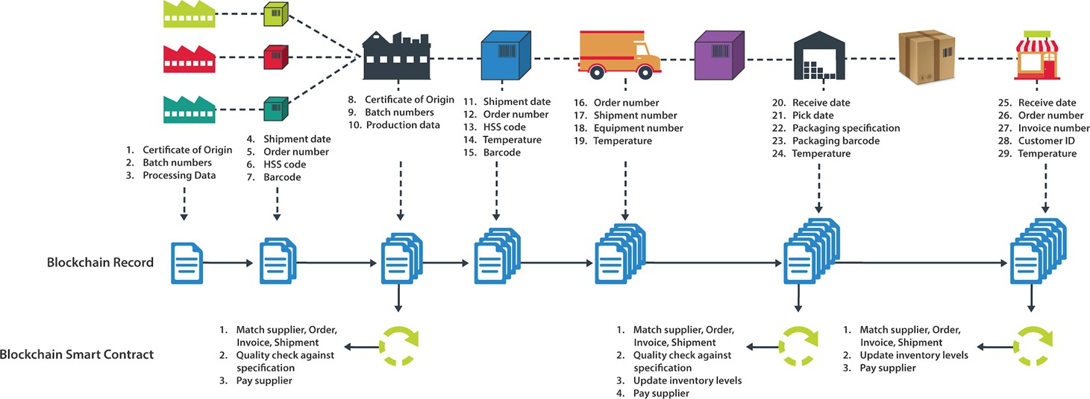

Slide 44
Type of Blockchain
Public blockchains:
Decentralized, democratized and transparent
Support a wide range of applications
Promote interoperability
Useful for crypto, trading tokenized assets, crowdsourcing and open-source work
Examples and platforms: Ethereum, Bitcoin, Solana
Private blockchains:
Restricted participation
Enhanced privacy and greater control
Centralized and at potentially higher risk for manipulation
Useful for precise functions within an organization
Examples and platforms: Hyperledger Fabric, MultiChain

Slide 45
Type of Blockchain
Hybrid blockchains:
Selective transparency and customizable levels of access
Balance between decentralization and control
Can be complex from a management and governance perspective
Useful for selective data-sharing within regulated industries
Examples and platforms: XinFin, IBM’s Blockchain Platform
Consortium blockchains:
Balanced between centralized and decentralized models
Shared cost and risk
Cross-organizational coordination can introduce complexities
Useful for collaborative processes
Example and platform: R3’s Corda

